Slide 1
Vue.js
dr Michał Kuciapski
Higher Banking School
Notes:
Wpisać program w ramach którego szkolenia są realizowane

Slide 2
Agenda
Front-end CSS frameworks trend
How to choose the right framework?
Front-end JS frameworks
Vue.js
What is Vue.js?
Comparison with other libraries/frameworks
Installing Vue.js
Dev Tools
Rendering
Lifecycle diagram
Referenced materials (selected):
https://vuejs.org/v2/guide
Andrea Passaglia, Vue.js 2 Cookbook, Packt Publishing 2017
Murat Dogan, Vue.js – Getting Started
Julio Bitencourt, Vue.js for beginners

Slide 3
Agenda
Vue.js
Application instance
Binding
Interpolations
Directives
Arguments
Modifiers
Shorthands
Computed properties
Binding HTML Classes
Binding Inline Styles
List Rendering
v-for
Event Handling
Components
SFC Concept
Ruter
Vuex

Slide 4
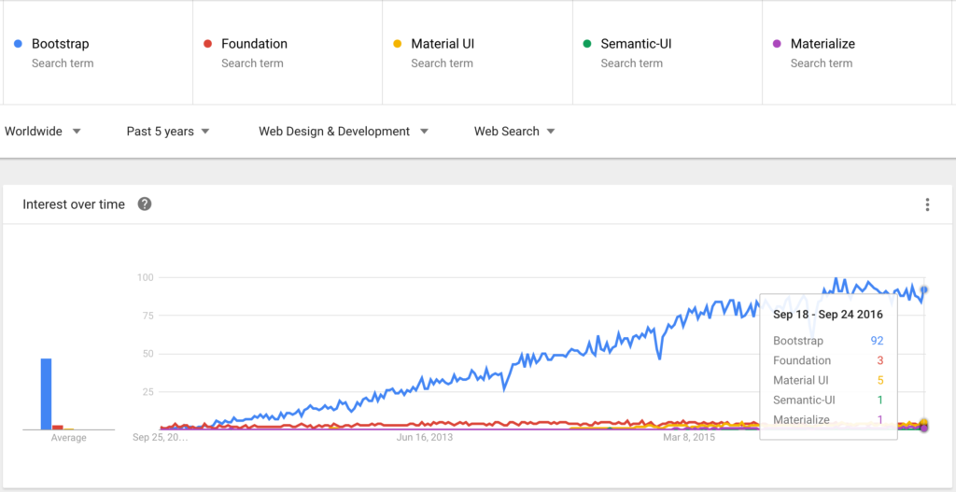
Front-end CSS frameworks trend

Slide 5

How to choose the right framework?
How mature are the frameworks / libraries?
Are the frameworks likely to be around for a while?
How extensive and helpful are their corresponding communities?
How easy is it to find developers for each of the frameworks?
What are the basic programming concepts of the frameworks?
How easy is it to use the frameworks for small or large applications?
What does the learning curve look like for each framework?
What kind of performance can you expect from the frameworks?
Where can you have a closer look under the hood?
How can you start developing with the chosen framework?

Slide 6
Front-end JS frameworks
Frameworks:
AngularJS - https://angular.io
Angular2/4 - https://angularjs.org
ReactJS - https://facebook.github.io/react
Vue.js - https://vuejs.org
Ember.js - https://www.emberjs.com
Meteor.js - https://www.meteor.com
Popularity:
Parametr/Framework | AngularJS | ReactJS | Vue.js
Stars (tousands) | 56,1 | 69,2 | 57,1
Commits (tousands) | 8,5 | 8,7 | 2
Contributors (tousands) | 1,6 | 1,0 | 0,1

Slide 7
Front-end JS frameworks
Efficiency
Parameter/Frameworks | angular v1.6.3-keyed | react v15.5.4-keyed | vue v2.3.3-keyed
create rows Duration for creating 1000 rows after the page loaded. | 251.848.00 (1.82) | 188.9310.93 (1.36) | 166.688.63 (1.20)
replace all rows Duration for updating all 1000 rows of the table (with 5 warmup iterations). | 278.2616.67 (1.88) | 201.036.40 (1.36) | 168.494.98 (1.14)
partial update Time to update the text of every 10th row (with 5 warmup iterations). | 12.551.95 (1.00) | 16.482.30 (1.03) | 17.332.90 (1.08)
select row Duration to highlight a row in response to a click on the row. (with 5 warmup iterations). | 8.083.62 (1.00) | 8.763.37 (1.00) | 9.311.66 (1.00)

Slide 8
Front-end JS frameworks
Efficiency
Parameter/Frameworks | angular | react v15.5.4-keyed | vue v2.3.3-keyed
swap rows Time to swap 2 rows on a 1K table. (with 5 warmup iterations). | 14.681.48 (1.00) | 14.660.90 (1.00) | 18.291.52 (1.14)
remove row Duration to remove a row. (with 5 warmup iterations). | 47.382.43 (1.12) | 47.223.20 (1.12) | 52.632.69 (1.24)
create many rows Duration to create 10,000 rows | 3108.702162.20 (2.34) | 1852.3629.03 (1.39) | 1587.5233.89 (1.19)
append rows to large table Duration for adding 1000 rows on a table of 10,000 rows. | 454.7942.09 (1.58) | 345.6210.40 (1.20) | 399.4610.98 (1.39)
clear rows Duration to clear the table filled with 10.000 rows. | 817.5937.16 (4.68) | 398.388.25 (2.28) | 254.515.03 (1.46)
startup time Time for loading, parsing and starting up | 118.125.14 (2.91) | 69.982.85 (1.73) | 56.552.48 (1.39)
slowdown geometric mean | 1.69 | 1.30 | 1.22

Slide 9
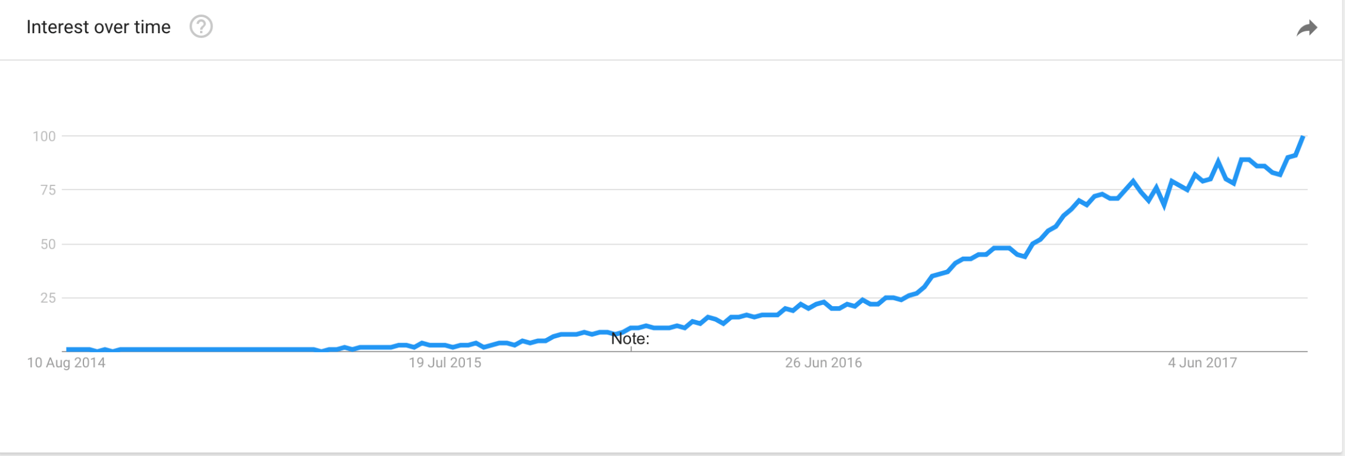
Vue - What is Vue.js?
Vue (pronounced /vjuː/, like view) is a progressive framework for building user interfaces.1
It was first released in February 2014 by ex-Google-employee Evan You
Only thing you need to know is HTML, CSS and JavaScript
It’s been popular since its last version 2.0
Vue is used by Alibaba, Baidu, Expedia, Nintendo, GitLab — a list of smaller projects can be found on madewithvuejs.com.

Slide 10
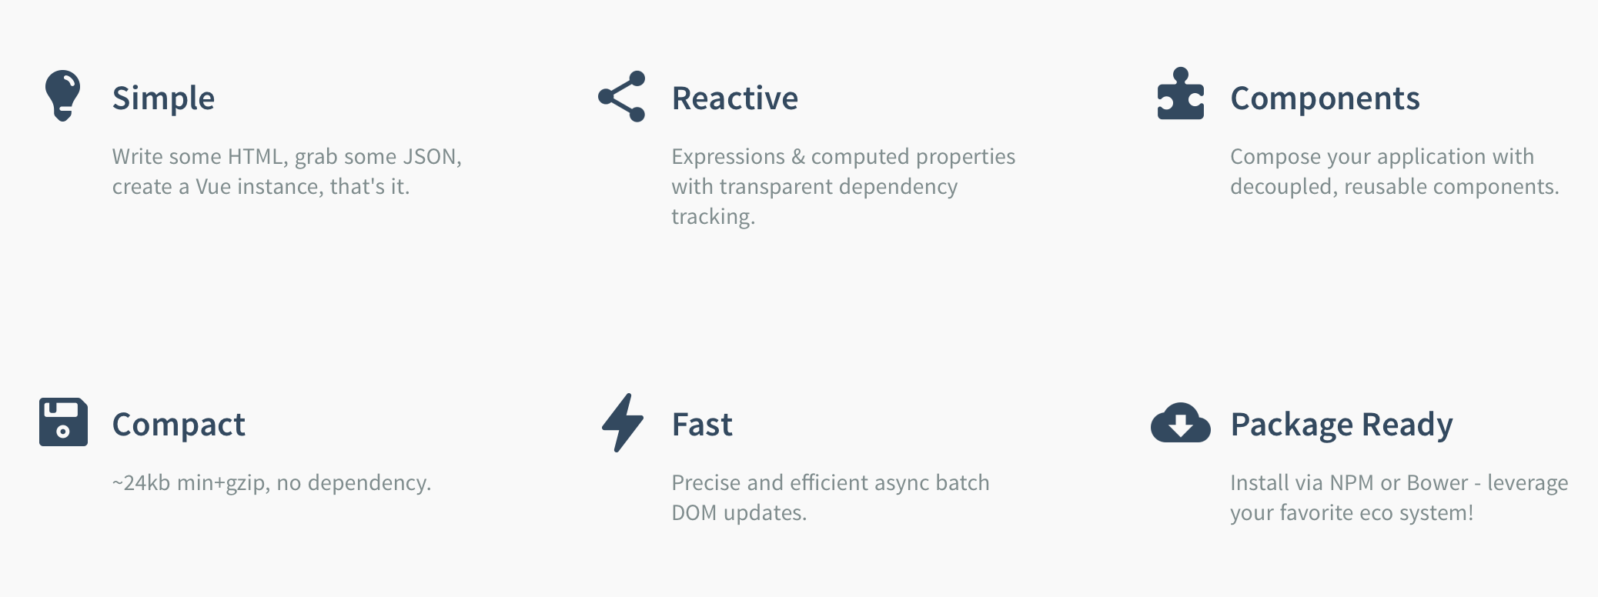
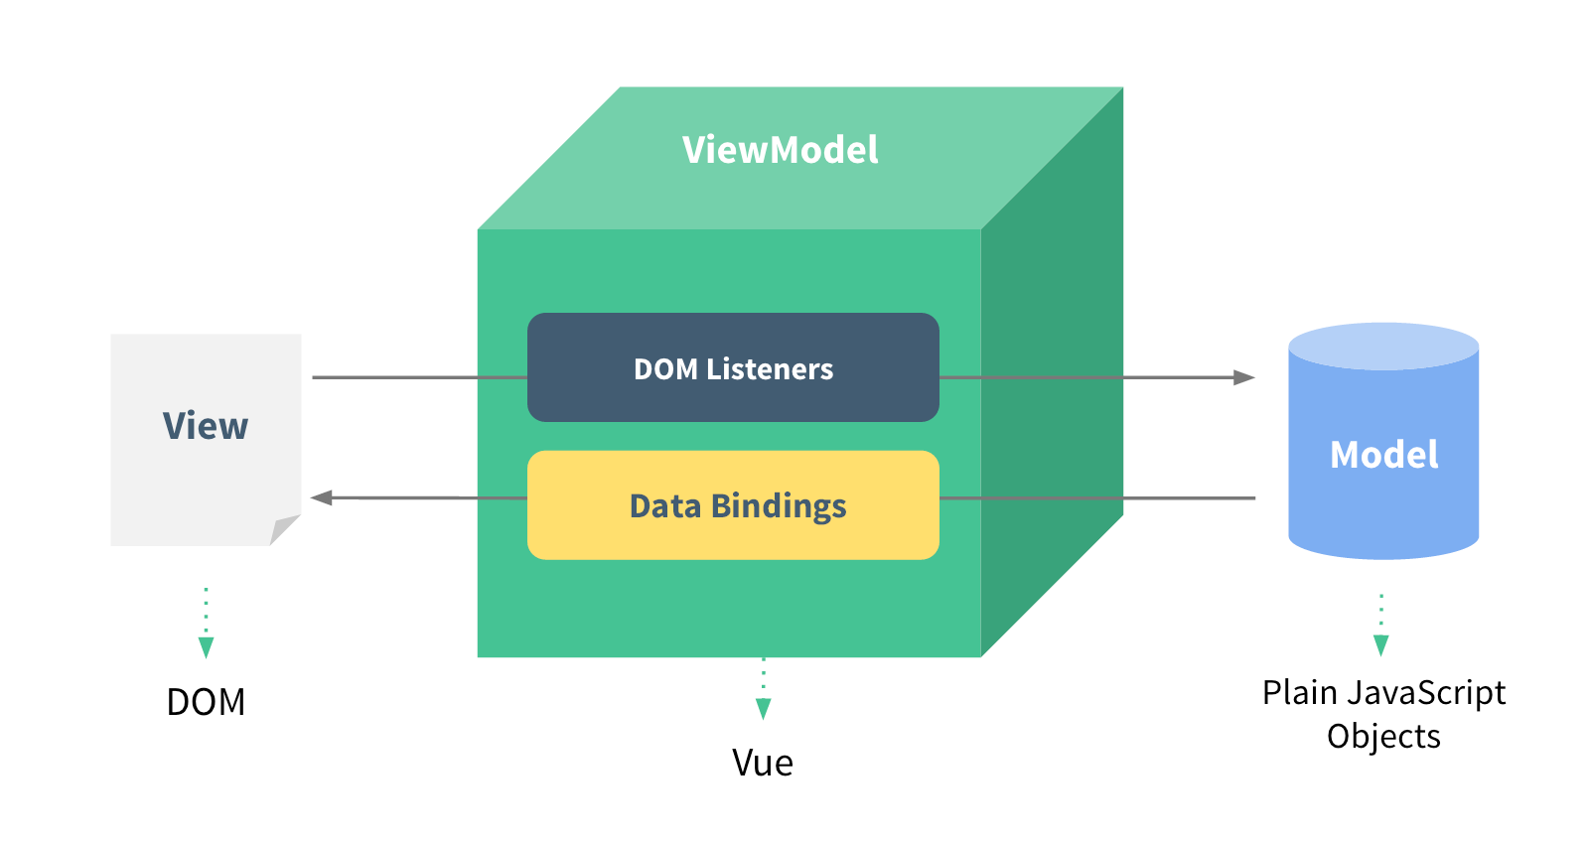
Vue - What is vue.js?

Slide 11
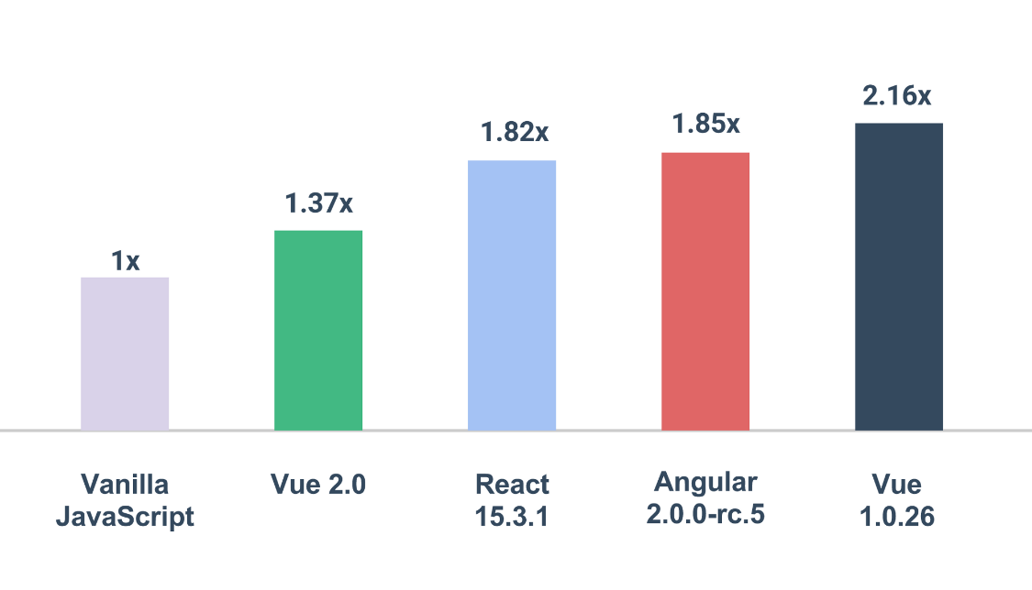
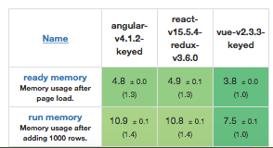
Vue - Comparison with other libraries/frameworks
Based on 3rd party benchmark, lower is better

Slide 12
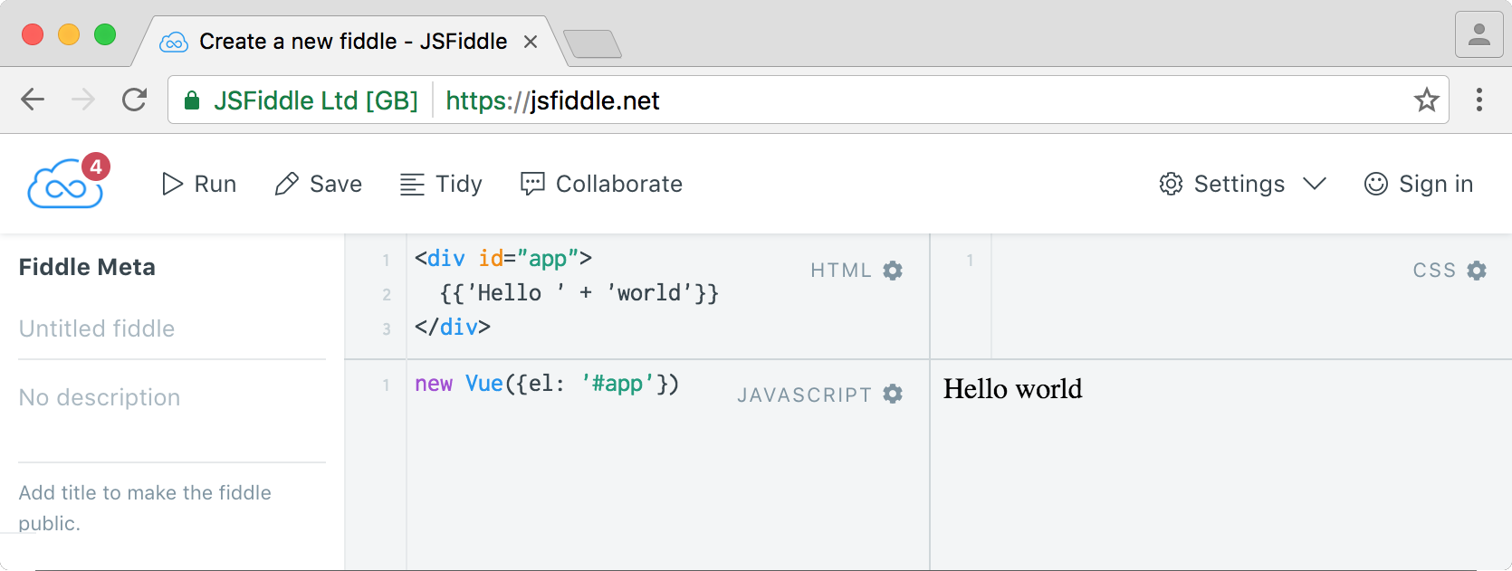
Vue - Installing Vue.js
You can install core library via CDN (Content Delivery Network)
If you want to always follow up the latest version of Vue, use unpkg:
https://unpkg.com/vue - Always redirect to the latest version of Vue!
https://unpkg.com/vue@[version]/dist/vue.min.js - to specific version.
You can install core library using Bower or npm
Open https://jsfiddle.net , choose the additional JS Framework; Vue.js

Slide 13
Zadanie – realizacja wspólna
Otwórz witrynę startową projektu i zaimportuj framework Vue.js (
<script src="https://cdn.jsdelivr.net/npm/vue@2.5.13/dist/vue.js">
</script><script src="https://cdn.jsdelivr.net/npm/vue"></script>
)
Projekt służący zarządzaniu wpisami odnośnie posiadanych kompetencji, np. Ionic, Vue.js, wraz z możliwościami społecznościowego dzielenia się informacjami.
Notes:
20486B
04: Developing ASP.NET MVC 4 Controllers
(More notes on the next slide)

Slide 14
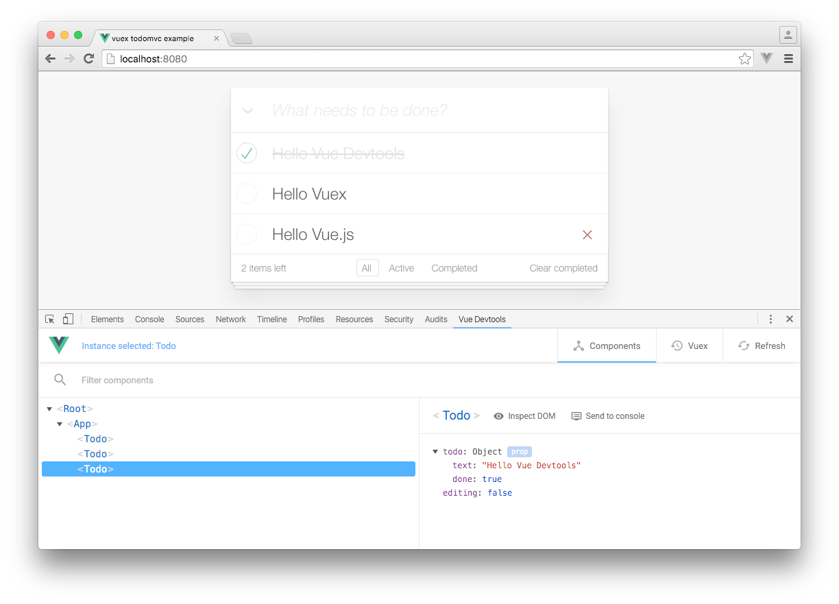
Vue - Dev Tools
https://github.com/vuejs/vue-devtools

Slide 15
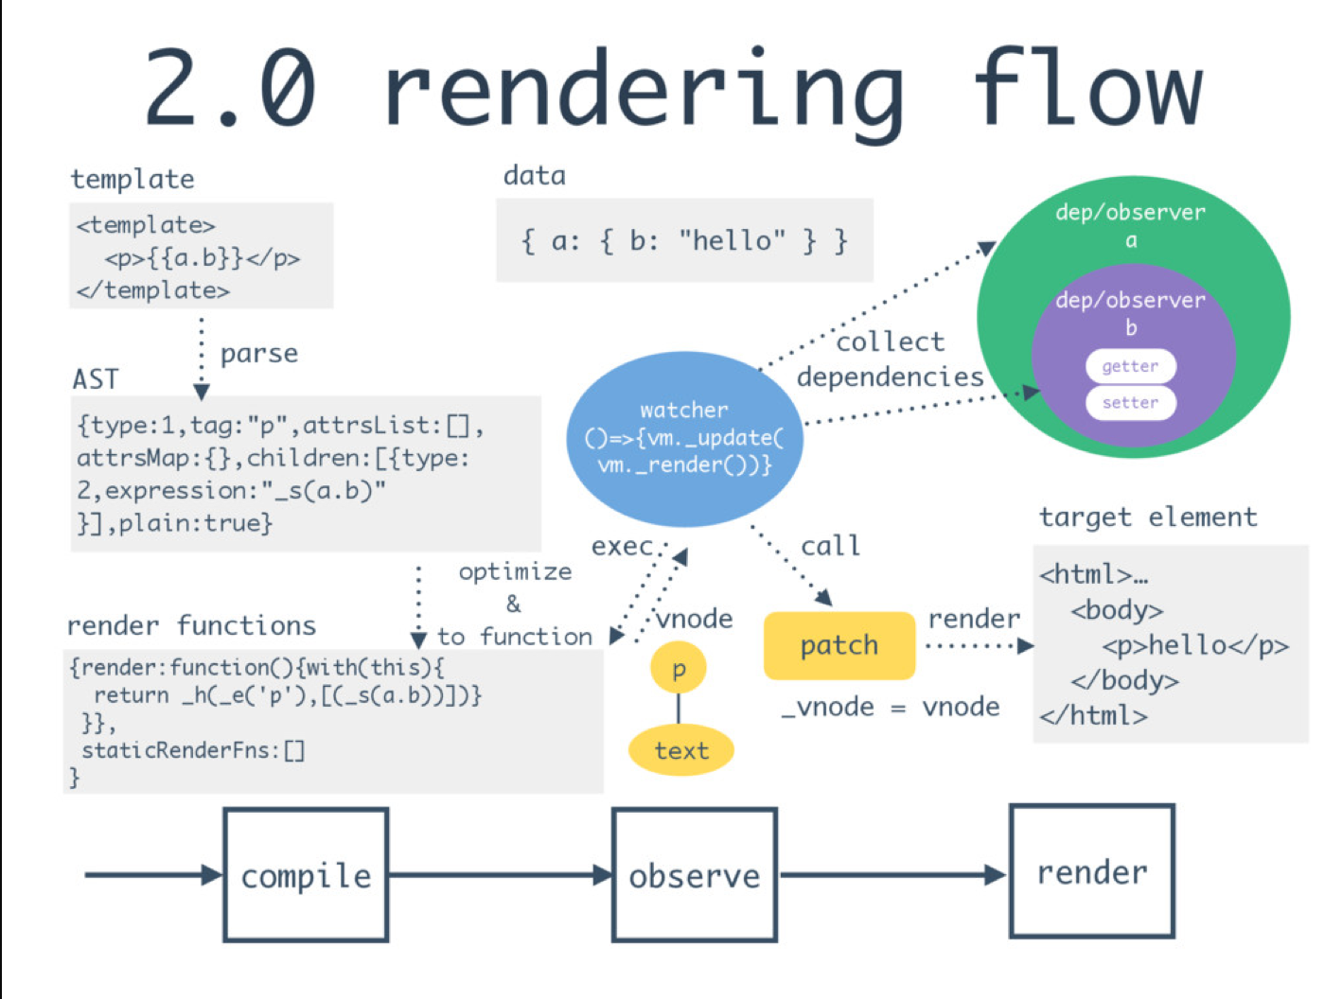
Vue - Rendering

Slide 16
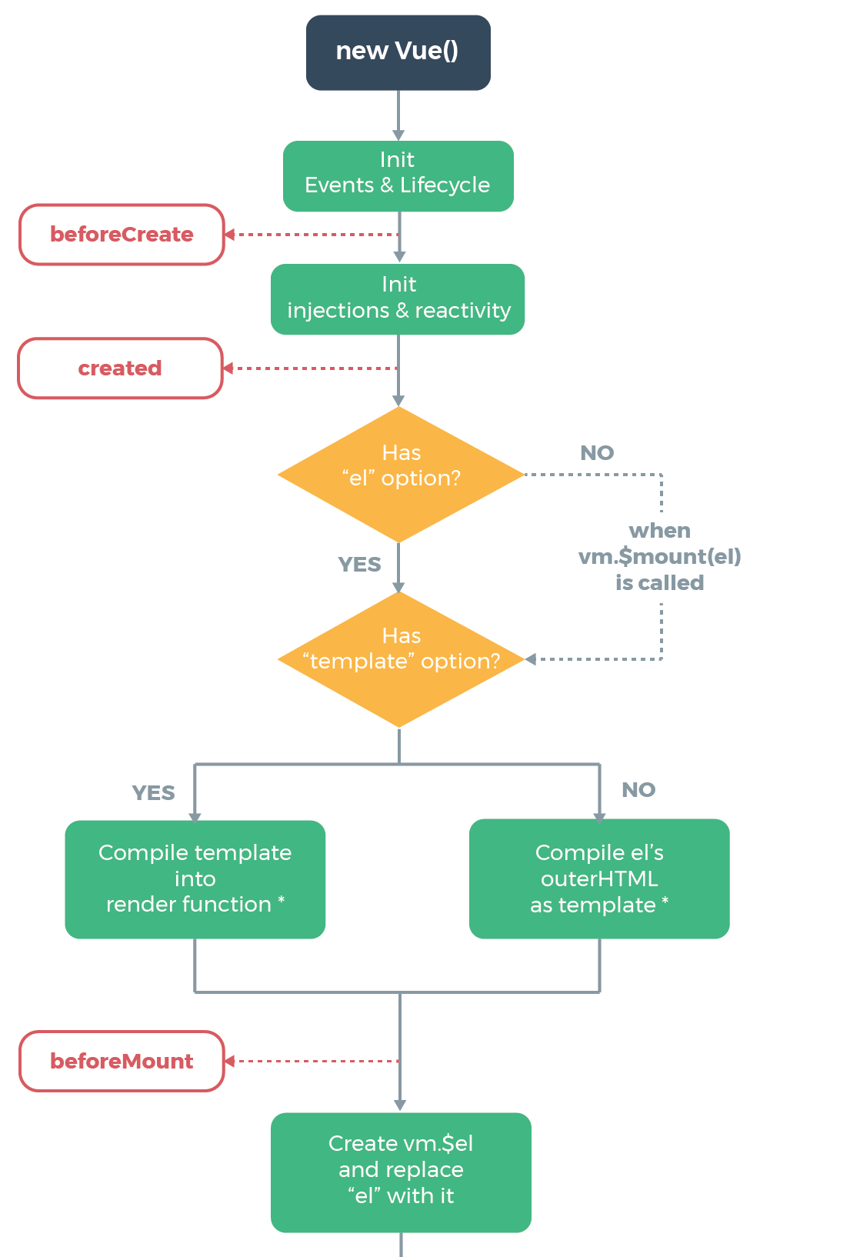
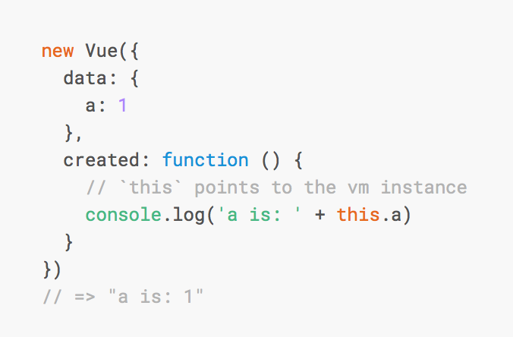
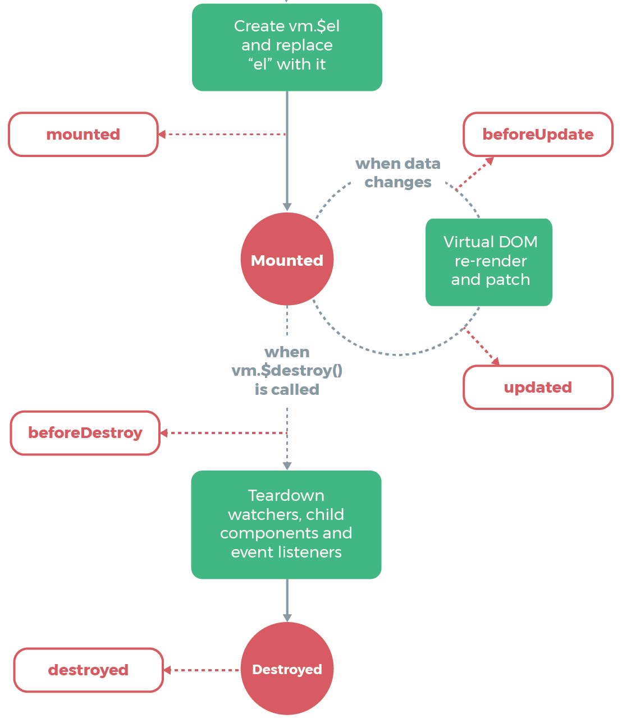
Vue – lifecycle diagram

Slide 17
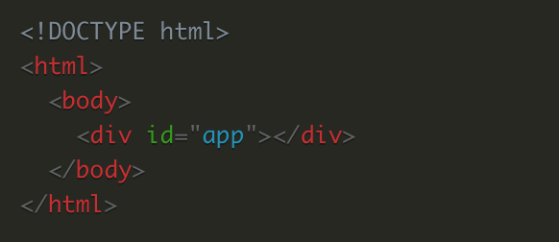
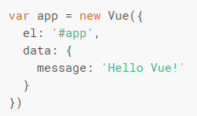
Vue – application instance
new Vue({el:'#app'}) will instantiate a new Vue instance.
Everything that we will write inside the <div> with the ID as app will be under the scope of Vue.
placing the #app on the body or html tag will throw an error.
App is referenced in JavaScript with el property.

Slide 18
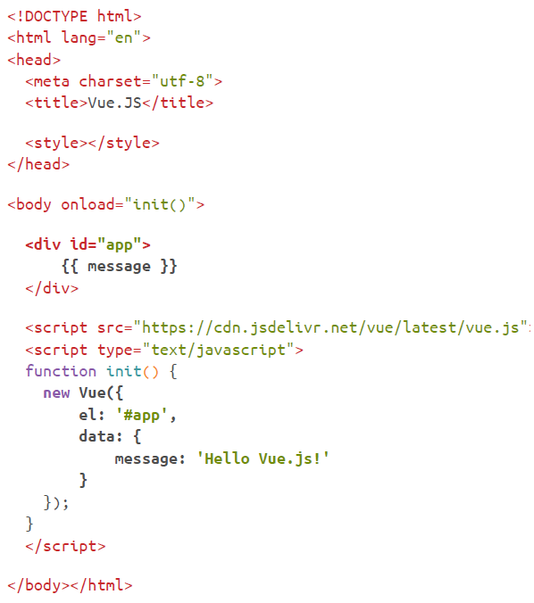

Slide 19
Zadanie – realizacja wspólna
Na stronie competences.html utwórz instancję aplikacji Vue.
Jako dane wstaw tablicę – plik: /js/competences.js.
Notes:
20486B
04: Developing ASP.NET MVC 4 Controllers
(More notes on the next slide)

Slide 20
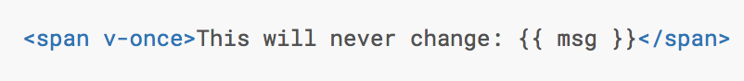
Vue - Binding
<div id="app">
<h1>{{message}}</h1>
<input type="text" v-model="message">
</div>
new Vue({
el: '#app',
data: {
message: 'Hello World'
}
});
<div id="app">
<h1>{{message}}</h1>
</div>
new Vue({
el: '#app',
data: {
message: 'Hello World'
}
});
One-way
Two-way

Slide 21

Vue - Binding
Attributes

Slide 22
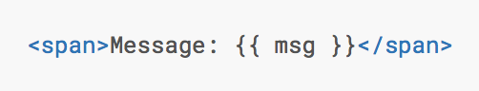
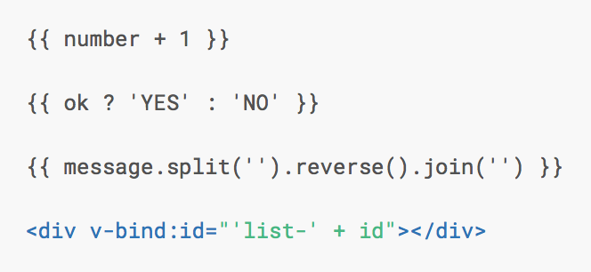
Vue - Interpolations
Simple
Expressions

Slide 23
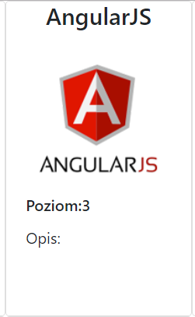
Zadanie – realizacja wspólna
Na stronie competences.html przygotuj kafelkę (ang. tile) w oparciu o Bootstrap Cards (https://getbootstrap.com/docs/4.0/components/card/) wyświetlającą kolejno dane jednej z kompetencji, której poziom (skala od 0 – 5, gdzie 0 to minimum) określiłbyś na najwyższy z wszystkich:
Nazwę kompetencji
Rysunek (podpowiedź: expressions v-bind:src=„…)
Poziom poznania
Opis
Notes:
20486B
04: Developing ASP.NET MVC 4 Controllers
(More notes on the next slide)

Slide 24
Zadanie – realizacja wspólna
Na stronie competences.html dla przygotowanej kafelki (ang. tile) wyświetlającej kolejno dane jednej z kompetencji zdefiniuj, aby tytuł kompetencji był z dużych liter – zastosuj Expressions.
Notes:
20486B
04: Developing ASP.NET MVC 4 Controllers
(More notes on the next slide)

Slide 25
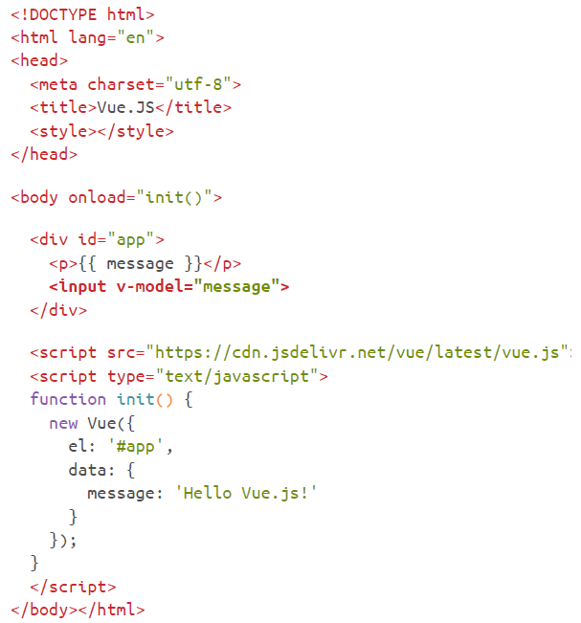
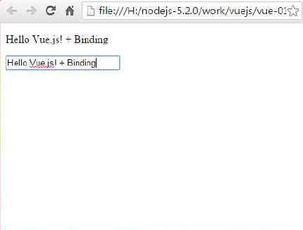

Slide 26
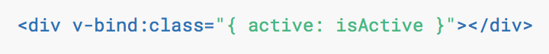
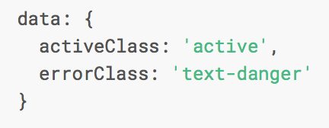
Vue - Binding HTML Classes
Object Syntax
Active class will be included if the data property isActive is true.
Array Syntax
Classes incuded accordingly to data’s
properties.

Slide 27
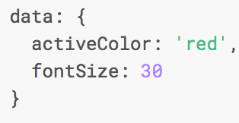
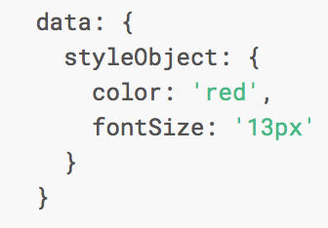
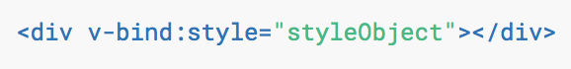
Vue - Binding Inline Styles
When you use a CSS property that requires vendor prefixes in v-bind:style, will automatically detect and add appropriate prefixes.
It looks almost like CSS, except it’s a JavaScript object. You can use either camelCase or kebab-case (use quotes with kebab-case) for the CSS property names.
It is often a good idea to bind to a style object directly so that the template is cleaner.
v-bind:style="{color: ocena < 3 ? 'red' : 'black'}">

Slide 28
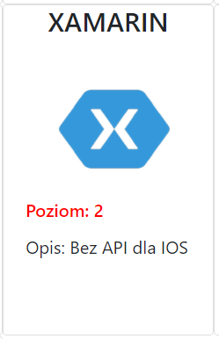
Zadanie – realizacja wspólna
Na stronie competences.html dla przygotowanej kafelki (ang. tile) wyświetlającej kolejno dane jednej z kompetencji zdefiniuj, aby poziom kompetencji był kolorem czerwonym, jeśli ma wartość mniejszą niż 2 - zastosuj Expressions dla atrybutu style.
Na stronie competences.html dla przygotowanej kafelki (ang. tile) wyświetlającej kolejno dane jednej z kompetencji zdefiniuj, aby poziom kompetencji był kolorem zielonym, jeśli ma wartość większą niż 3 - zastosuj Expressions dla atrybutu class.
Notes:
20486B
04: Developing ASP.NET MVC 4 Controllers
(More notes on the next slide)

Slide 29

Vue - Arguments
“argument”, denoted by a colon after the directive name.
href attribute to the value of the expression url.

Slide 30
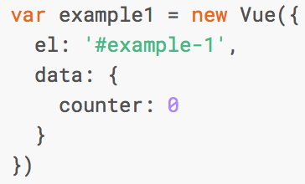
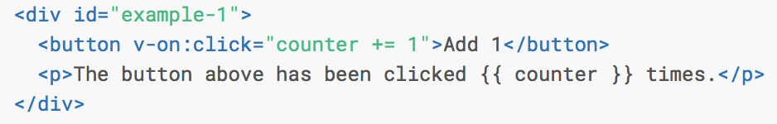
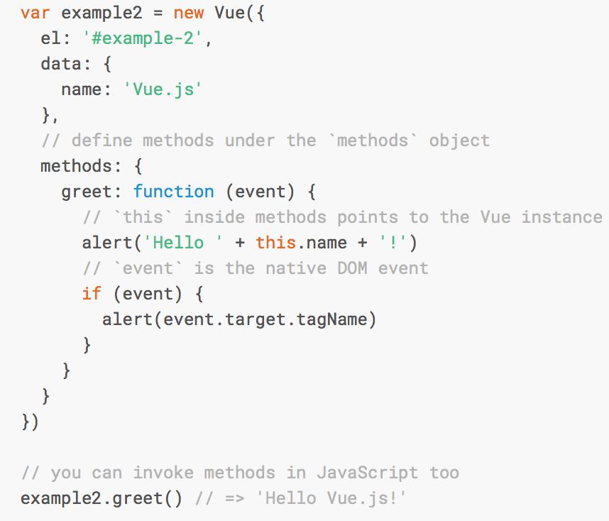
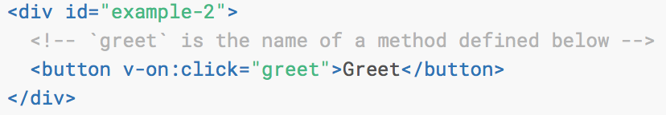
Vue - Event Handling
v-on directive to listen to DOM events and run some JavaScript when they’re triggered.
v-on can also accept the name of a method you’d like to call.

Slide 31
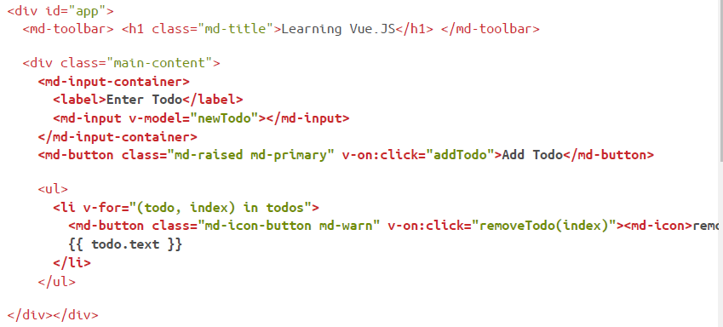

Slide 32
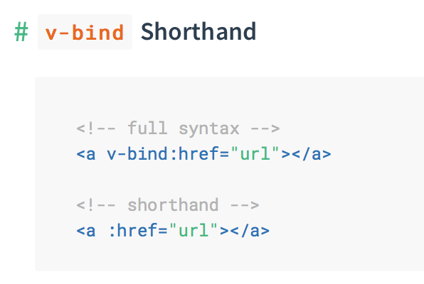
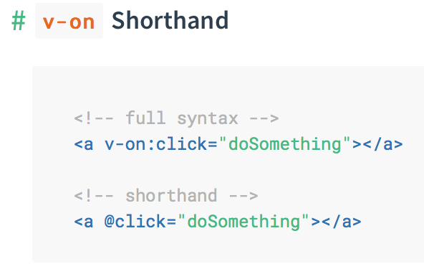
Vue - Shorthands
The v- prefix serves as a visual cue for identifying Vue-specific attributes in your templates - verbose for some frequently used directives.

Slide 33
Zadanie – realizacja wspólna
Na stronie competences.html dodaj interfejs dla wyszukiwania kompetencji oparte o pole tekstowe. Zdefiniuj zdarzenie wprowadzania znaku w polu tekstowym powodujące wywołanie metody searchCompetence, która (rozwiązanie tymczasowe) powoduje wypisanie w oknie (alert) podanego tekstu wyszukiwania. Ponadto zdefiniuj binding (v-model) powodujący, że po wpisaniu tekstu w pole wyszukiwania pojawia się on w etykiecie (rozwiązanie tymczasowe).
(https://getbootstrap.com/docs/4.0/components/input-group)
Notes:
20486B
04: Developing ASP.NET MVC 4 Controllers
(More notes on the next slide)

Slide 34
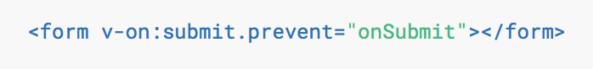
Vue - Modifiers
Modifiers are special postfixes denoted by a dot, which indicate that a directive should be bound in some special way.
The .prevent modifier tells the v-on directive to call event.preventDefault() on the triggered event:

Slide 35
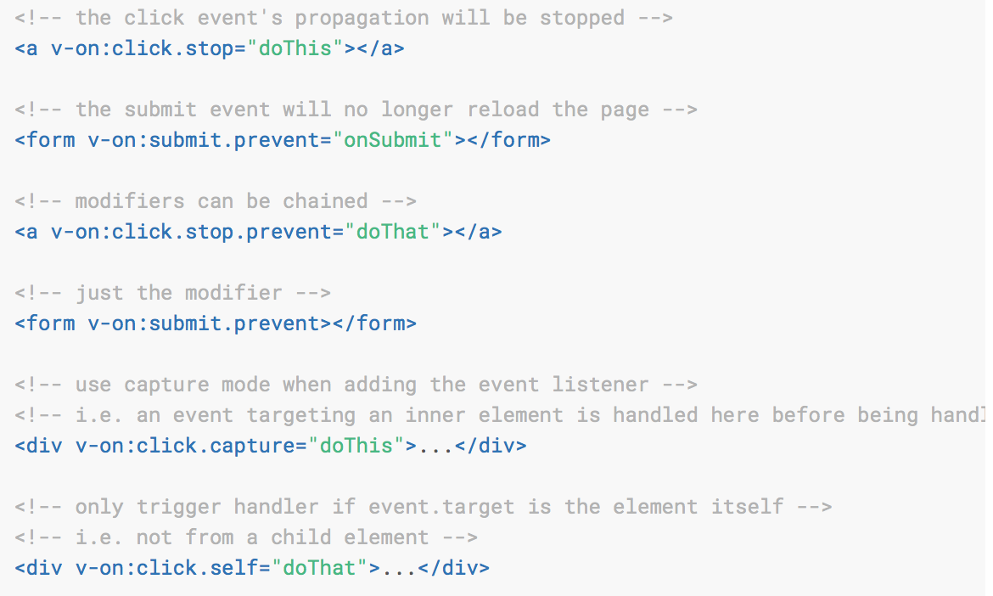
Vue - Event Modifiers
It is a very common need to call event.preventDefault() or event.stopPropagation() inside event handlers.
It would be better if the methods can be purely about data logic rather than having to deal with DOM event details.
Recall that modifiers are directive postfixes denoted by a dot:
.stop
.prevent
.capture
.self
.once

Slide 36
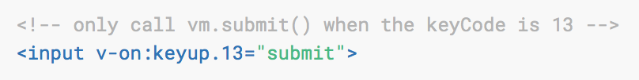
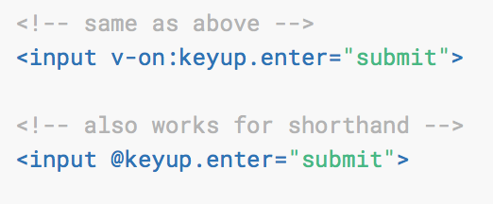
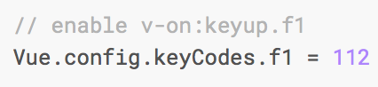
Vue - Key Modifiers
Vue also allows adding key modifiers for v-on when listening for key events.
key modifier aliases:
.enter
.tab
.delete (captures both “Delete” and “Backspace” keys)
.esc
.space
.up
.down
.left
.right
You can also define custom key modifier aliases via the global config.keyCodes
<input v-on:keyup.f1="submit">

Slide 37
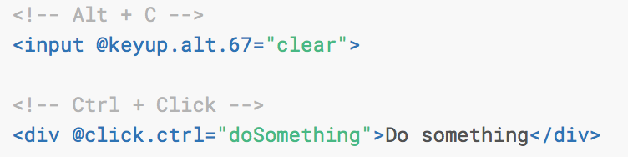
Vue - Key Modifiers - Modifier Keys
It is possible to use the following modifiers to trigger mouse or keyboard event listeners only when the corresponding modifier key is pressed:
.ctrl
.alt
.shift
.meta - Macintosh keyboards (⌘), on Windows keyboard (⊞)

Slide 38
Vue - Mouse Button Modifiers
These modifiers restrict the handler to events triggered by a specific mouse button.
New in 2.2.0+:
.left
.right
.middle

Slide 39
Zadanie – realizacja wspólna
Na stronie competences.html dodaj przycisk (submit) o tytule „Zapisz tekst zapytania” pozwalający (funkcjonalność implementowana później) zapisać treść zapytania poprzez przesłanie jej jako AJAX do serwera.
Zdefiniuj, aby kliknięcie na przycisk (submit) nie powodoło przesłania danych na serwer, ale wywołanie metody saveQuery, która (rozwiązanie tymczasowe) jako okno (alert) wyświetla treść zapytania.
Notes:
20486B
04: Developing ASP.NET MVC 4 Controllers
(More notes on the next slide)

Slide 40
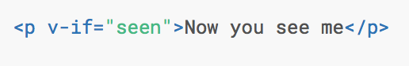
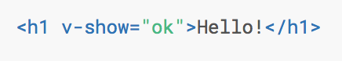
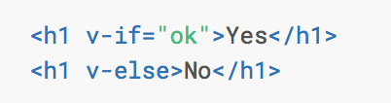
Vue - Directives
Directives are special attributes with the v- prefix.
Directive attribute values are expected to be a single JavaScript expression (with the exception for v-for).
A directive’s job is to reactively apply side effects to the DOM when the value of its expression changes.
v-if
v-show
v-if has higher toggle costs while v-show has higher initial render costs.

Slide 41
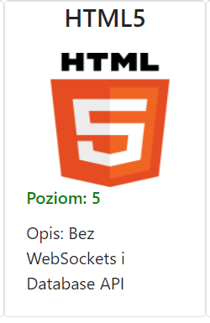

Zadanie – realizacja wspólna
Na stronie competences.html napisz kod, aby wyświetlane były tylko kafelki, gdzie poziom kompetencji jest większy od 0 – v-if/v-show.
Na stronie competences.html napisz kod, aby opis kompetencji był wyświetlany tylko jeśli istnieje – v-if.
[Opcjonalne] Na stronie competences.html napisz kod, aby poziomy kompetencji wyświetlane były nie jako liczby (0-5), ale tekst (brak, podstawowy, itd.) – v-if.
Notes:
20486B
04: Developing ASP.NET MVC 4 Controllers
(More notes on the next slide)

Slide 42
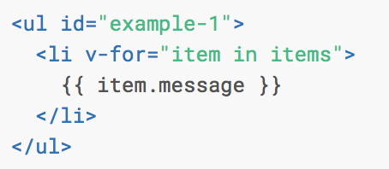
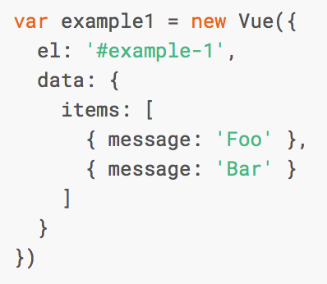

Vue - List Rendering
We can use the v-for directive to render a list of items based on an array.

Slide 43
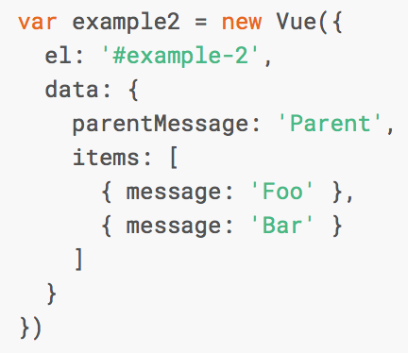
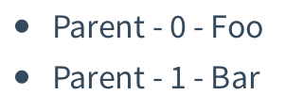
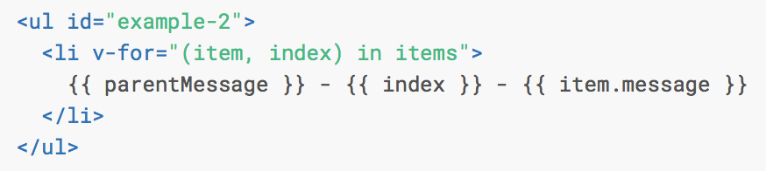
Vue - List Rendering
Inside v-for blocks we have full access to parent scope properties.
v-for also supports an optional second argument for the index of the current item.

Slide 44
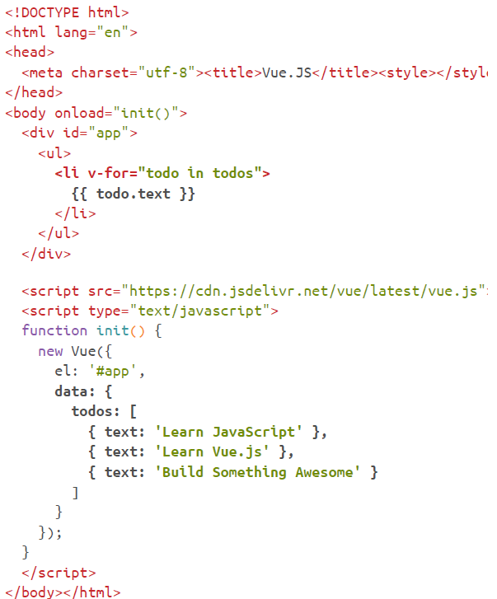


Slide 45






Vue – v-for
We can also use v-for to iterate through the properties of an object.
v-for can also take an integer - in this case it will repeat the template that many times.
When they exist on the same node, v-for has a higher priority than v-if.

Slide 46



Slide 47

Zadanie – realizacja wspólna
Na stronie competences.html napisz kod generowania kafelek dla wszystkich kompetencji – v-for
(układ jako flex: https://www.w3schools.com/cSS/css3_flexbox.asp).
Notes:
20486B
04: Developing ASP.NET MVC 4 Controllers
(More notes on the next slide)

Slide 48


Vue - Computed properties
Putting too much logic into your templates can make them bloated and hard to maintain.

Slide 49

Vue - Computed properties
Computed properties are cached based on their dependencies. A computed property will only re-evaluate when some of its dependencies have changed.

Slide 50



Slide 51



Slide 52
Vue - Computed properties - Example
<!-- The template -->
<template id="counter-template">
<h1>{{ header }} {{ count }} {{ status }}</h1>
<button @click="count += 1">Click me!</button>
</template>
Vue.component('counter', {
template: '#counter-template',
data: function() {
return { count: 0 }
},
computed: {
status: function() {
return this.count > 10 ? 'Good!' : 'Normal';
}
}
});
new Vue({
el: '#app',
});

Slide 53

Zadanie – realizacja wspólna
Na stronie competences.html w oparciu o interfejs dla wyszukiwania kompetencji zapewnij wyszukiwanie kompetencji po ich nazwie (występowanie tekstu) - odwołania nie do bazowej listy kompetencji, ale przefiltrowanej listy kompetencji (computed property). Filtrowanie - https://developer.mozilla.org/en-US/docs/Web/JavaScript/Reference/Global_Objects/Array/filter.
Notes:
20486B
04: Developing ASP.NET MVC 4 Controllers
(More notes on the next slide)

Slide 54

Zadanie – realizacja wspólna
[Opcjonalne] Zdefiniuj wyszukiwanie po wielu słowach oddzielanych spacją - np. „html css” zwróci kafelki HTML5 i CSS3.
[Opcjonalne] Zdefiniuj listę wyboru poziomu kompetencji (0-5) powodującą wyświetlenie wyłącznie kompetencji o wskazanym poziomie – w połączeniu z wyszukiwaniem kompetencji.
[Opcjonalne] Napisz kod powodujący, że lista kompetencji jest posortowana po nazwach – zdarzenie created (https://www.w3schools.com/jsref/jsref_sort.asp).
Notes:
20486B
04: Developing ASP.NET MVC 4 Controllers
(More notes on the next slide)

Slide 55


Vue - components
Help to extend basic HTML elements to encapsulate reusable code. At a high level, components are custom elements that Vue’s compiler attaches behavior to.
All Vue components are also Vue instances, and so accept the same options object (except for a few root-specific options) and provide the same lifecycle hooks.

Slide 56

Vue – components

Slide 57


Vue - components

Slide 58


Vue – components (Emit)
Parent component can listen to the events emitted from a child component.

Slide 59
Vue - components
<!-- Your App -->
<div id="app">
<counter header="Up"></counter>
<counter header="Down"></counter>
</div>
<!-- The template -->
<template id="counter-template">
<h1>{{ header }} {{ count }}</h1>
<button @click="count += 1">Click me!</button>
</template>
Vue.component('counter', {
template: '#counter-template',
data: function() {
return { count: 0 }
}
});
new Vue({
el: '#app',
});

Slide 60

Vue - SFC Concept (Single File Components)
CommonJS modules
Component-scoped CSS
You can specify language attributes to write more specific code.

Slide 61
Zadanie – realizacja wspólna
Na stronie competences.html napisz, aby kafelka z danymi kompetencji była komponentem.
[Opcjonalne] Dla komponentu napisz kod, aby po najechaniu na niego była wypisywana (alert, okno modalne, inne rozwiązanie) lista kompetencji, które są na tym samym poziomie umiejętności.
Notes:
20486B
04: Developing ASP.NET MVC 4 Controllers
(More notes on the next slide)

Slide 62
Vue - ruter
Creating a SPA with Vue.js + vue-router:
Not only client-side routing (hash / history API), but also module based URL mapping:
nested routes and sub components
async load
others.
The following hooks are available:
data, activate, deactivate, canActivate, canDeactivate, canReuse
onEnter, onLeave, onChange in Vue-Router since 0.8.0

Slide 63



Vue - ruter
Nested Routes and Sub Components & Hooks
Example URL change: /a/b/c -> /a/d/e
1. Reusability phase
Check reusability
2. Validation phase
Check if all current components can be activated / deactivated
3. Activation phase
Deactivate current components and activate new components with data hook

Slide 64
Vue - ruter
Code Example
main.vue
router.map({
'/about': {
component: require('./components/about.vue')
},
'/user/:userId': {
component: require('./components/user/index.vue'),
subRoutes: {
'profile/:something': {
component: require('./components/user/profile.vue')
}
},
'*': {
component: require('./components/not-found.vue')
},
})
app.vue
<template>
<div>
<p v-show="authenticating" style="color:red">Authenticating...</p>
<h1>App Header</h1>
<a v-link="{ path: '/about' }">about</a>
<a v-link="{ path: '/user/1234/profile/what' }">user</a>
<a v-link="{ path: '/mypage' }">mypage</a>
<router-view class="view" transition="test" transition-mode="out-in" keep-alive></router-view>
</div>
</template>
components/user/index.vue
<template>
<div>
<h2>User yo</h2>
<router-view></router-view>
</div>
</template>
components/user/profile.vue

Slide 65

Vuex
Official redux inspired flux framework for Vue.js
Vuex is more fit for Vue.js with efficient reactive system such as data reactive rendering and components systems.

Slide 66
Vuex - features
Store
basically a container that holds your application reactive states
only way to change a store's state is by explicitly dispatching mutations
Mutation
sync (can not be async)
split into modules with corresponding slice of the state
Action
dispatch mutations
can be async

Slide 67
Vuex - advantages
simple unidirectional flow (less side effects)
easy undo/redo - time travel
hot reloading
easy test

Slide 68

Vuex - flow

Slide 69
Vuex – mutation example
Mutation (a name and a handler) mutates states with synchronous functions:
Vuex store's state is made reactive by Vue;
when we mutate the state, Vue components observing the state will update automatically.
import Vuex from 'vuex'
const store = new Vuex.Store({
state: {
count: 1
},
mutations: {
INCREMENT (state) {
// mutate state
state.count++
}
}
})
Must be called by dispatch in Action
store.dispatch('INCREMENT')

Slide 70
Vuex - getter
A getter provides accessing way to store data from components:
Components are not allowed to directly mutate a state.
It allows us to reuse computed methods (e.g. totals, averages) through a getter.
Getter Example
// getters.js
export function filteredMessages (state) {
return state.messages.filter(message => message.threadID === state.currentThreadID)
}
- Component
<script>
export default {
vuex: {
getters: {
filteredMessages
}
}
}
</script>
<template>
<div>
<ul>
<li v-for="msg in filteredMessages">{{mgs.title}}</li>
</ul>
</div>
</template>

Slide 71
Vuex – form handling
v-model directly rewrites store data. This is not the Vuex way (throws an error in strict mode).
The Vuex way with v-model:
Set a getter value to form value
Dispatch action by UI event (e.g. onclick)
Template:
<input :value="message" @input=“updateMessage”>
JS:
actions: {
updateMessage: ({ dispatch }, e) => {
dispatch('UPDATE_MESSAGE', e.target.value)
}
}

